Slide 1

Mini project Presentation SESSION 2021-22
Department of Computer Science And Engineering
ABES Engineering College, Ghaziabad, UP
Team Name :ALT-SHIFT
Class & Section :CSE-B
Member Name University Roll No Admission No
Prabhat Yadav 1900320100107 2019B101037
Kaushlendra Gupta 1900320100074 2019B101155
Pawan Kumar 1900320100106 2019B101089

Slide 2
KPP MART
KPP MART is an E-Commerce website specializes is buying and selling of smartphones.
As people become more accustomed to using the internet, they view ordering products and services online as a time saving and cost-saving experience, which is the very essence of our online shopping system.
Customers will save their time and energy of going to shops and shopkeepers will save there rent for large space

Slide 3
Project description
KPP MART empowers clients to purchase mobiles or products from anyplace on the web.
This application publicizes a portion of the items for shopping. To purchase items, the client needs to make a Login or Sign up.
The individuals who don’t have a Login can just view the accessible item. They can’t get it. When the client has made the Login, not just he can see the items, he can likewise add the item to the cart to purchase those items. This application at that point produces bills for that specific client.
After the affirmation, the client needs to enter his card details or choose cash on delivery.
The client later can choose to cancel the item if he/she wishes.

Slide 4
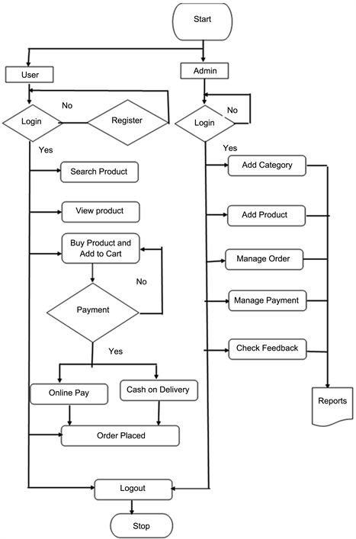
Project flow

Slide 5
Technology used
HTML
CSS
JAVASCRIPT

Slide 6

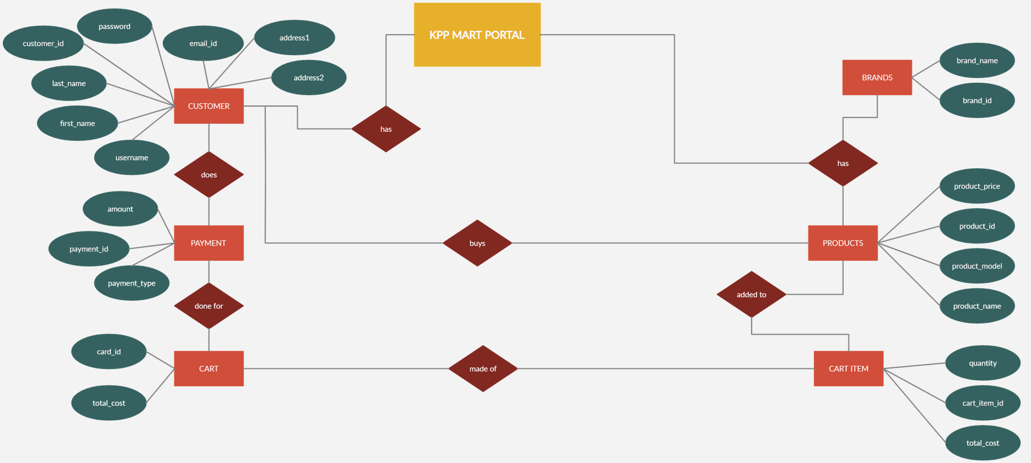
E-r diagram

Slide 7
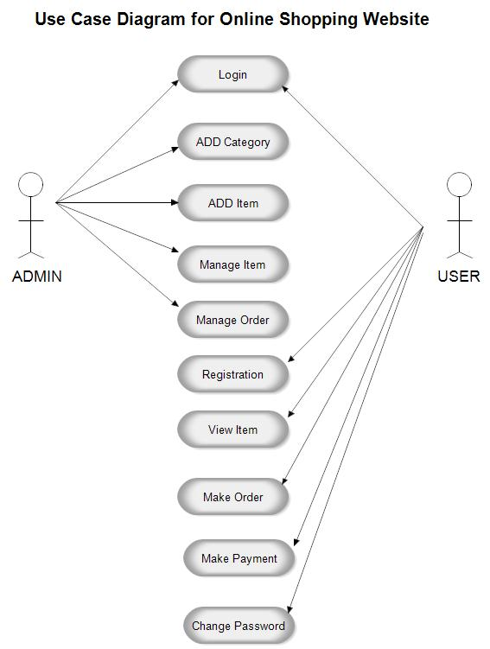
Use case diagram
KPP MART USE CASE DIAGRAM

Slide 8
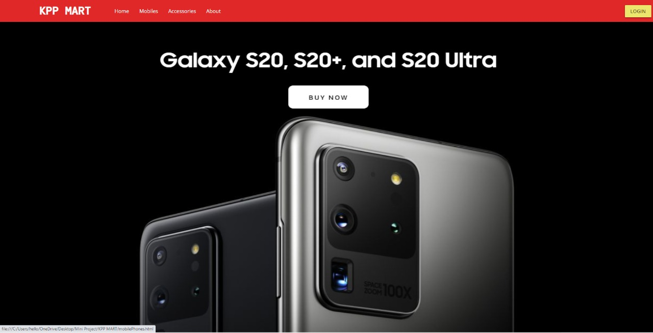
SCREENS

Slide 9
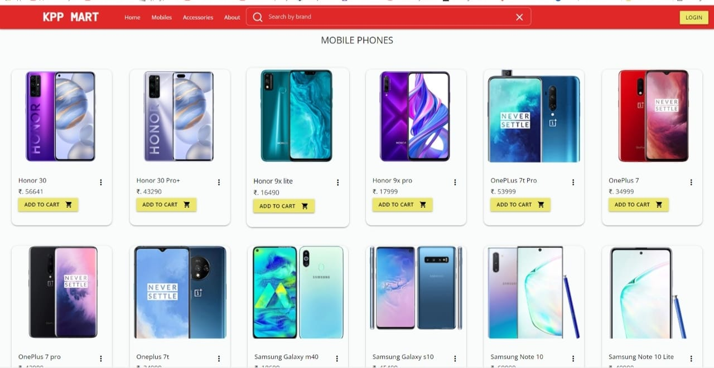
Screens

Slide 10
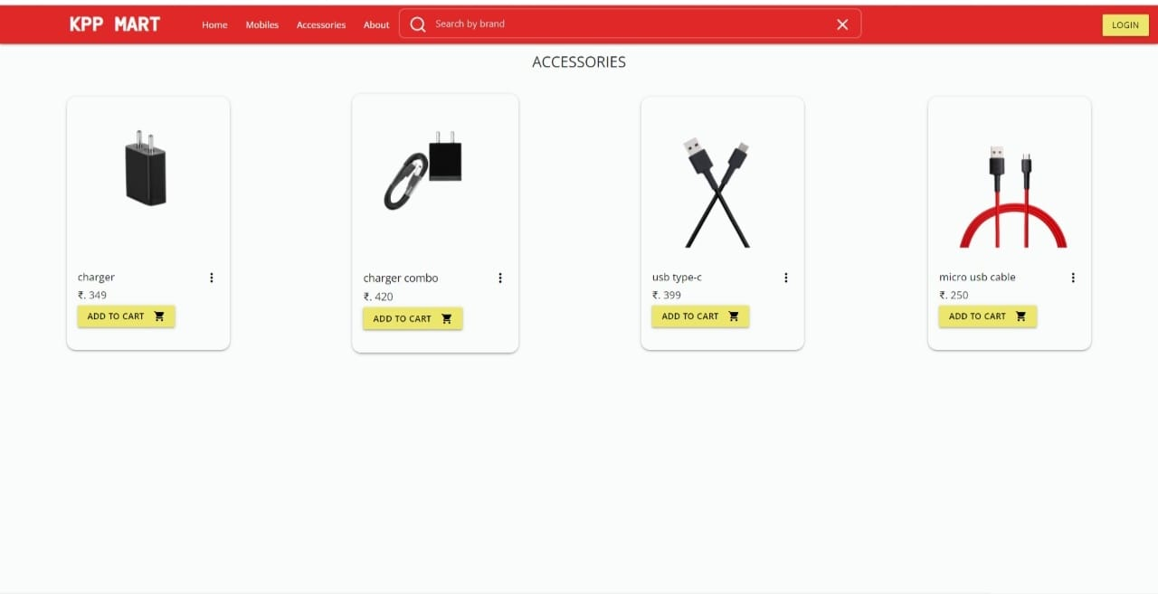
SCREENS

Slide 11
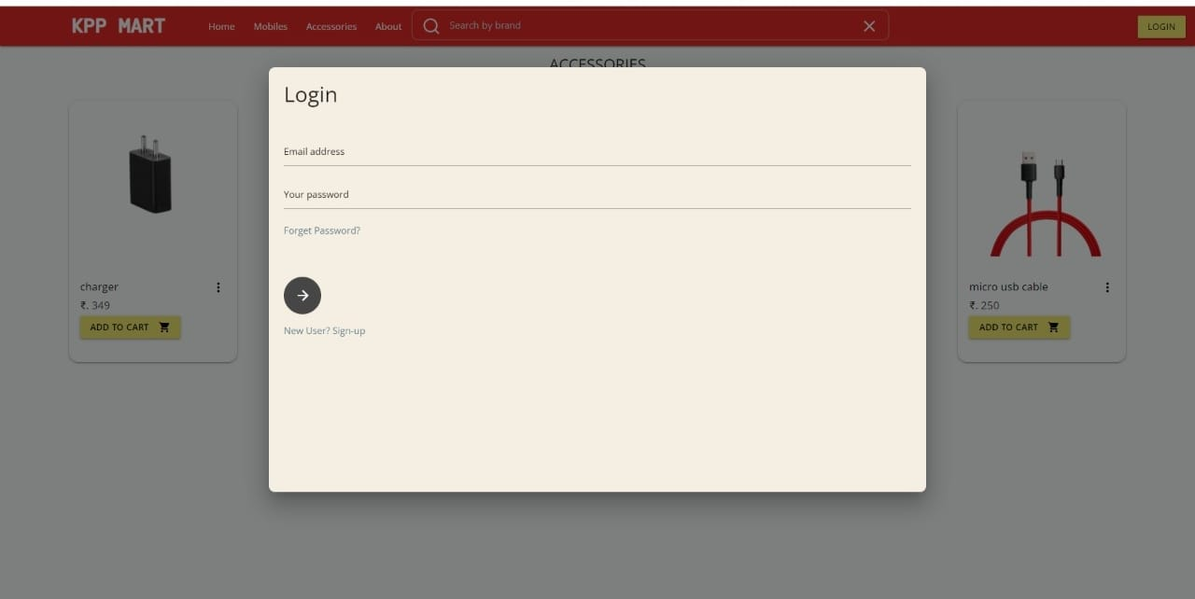
Screens

Slide 12
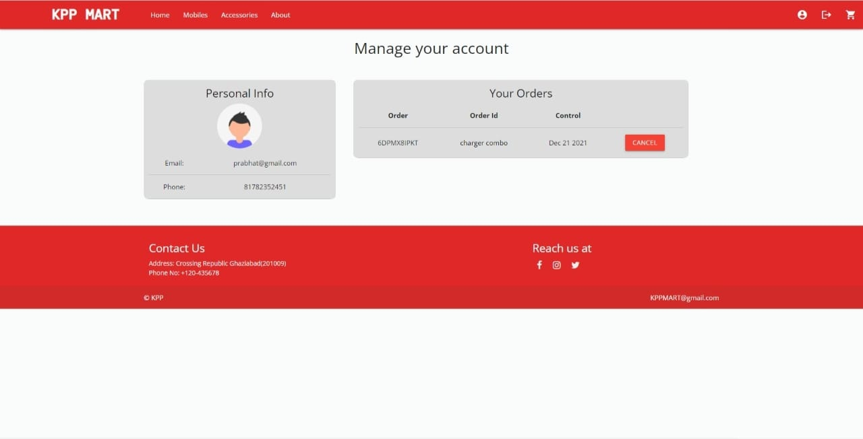
SCREENS

Slide 13
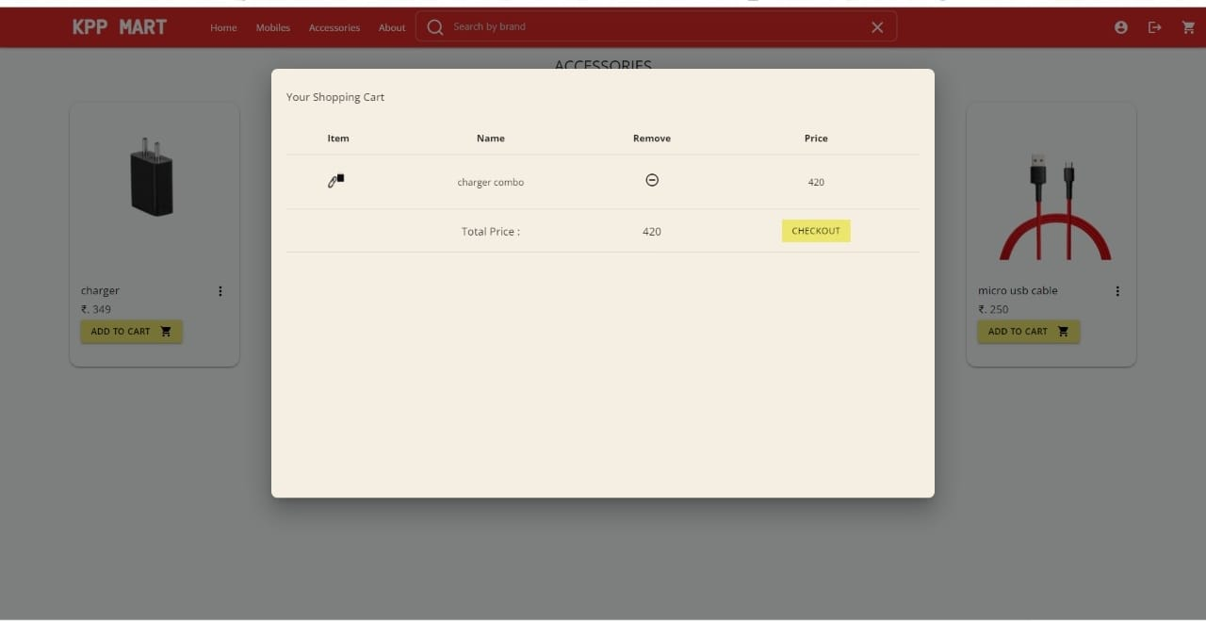
Screens

Slide 14
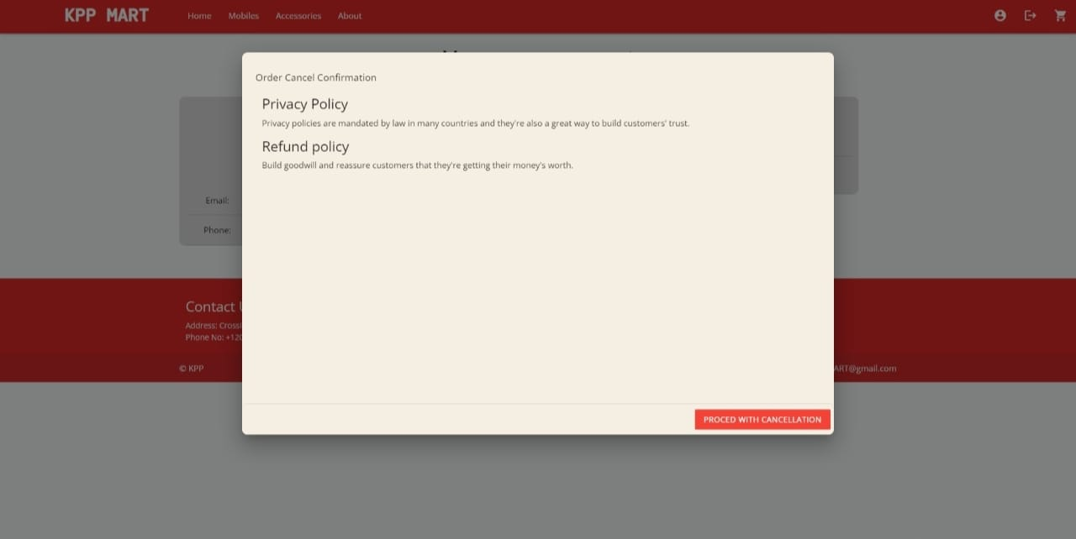
Screens

Slide 15
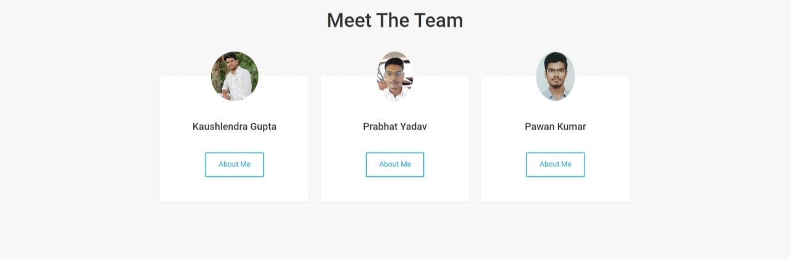
Screens

Slide 16


